Slide 1
Equality in higher education: issues, ideas and initiatives
Gary Loke
Head of Policy, Equality Challenge Unit

Slide 2
Equality Challenge Unit
ECU works to further and support equality and diversity
for staff and students in higher education and seeks to
ensure that staff and students are not unfairly
excluded, marginalised or disadvantaged because of
age, disability, gender identity, marital or civil
partnership status, pregnancy or maternity status, race,
religion or belief, sex, sexual orientation, or through
any combination of these characteristics or other unfair
treatment.
1

Slide 3
Recent changes to the HE sector
Economic conditions
HE in FE
International trends
Demographic changes
Government higher education reforms
2

Slide 4
Government higher education reforms
Privatisation
Increase in student fees (England)
Phasing out of teaching grants
Increase in student loan threshold
Removal of student numbers cap
3

Slide 5
Students
  Important to recognise that students are heterogeneous.
  Different people will have different considerations about pursuing HE.
  Total number of students fallen since the £9,000 cap introduced.
Ethnicity
Gender
Disability
Age
Sexual orientation
Marital status
Religion and belief
Caring responsibilities
Gender identity
Socioeconomic class
Parental education
English as a second language
International
Schooling
Family and friends

Slide 6
Impacts of the changes
“It is difficult to distinguish between transient and permanent effects of the reforms and to determine exactly how demand for higher education has been affected by new fee increases.”
(HEFCE)
4

Slide 7
Gender
Consistently more women then men applying and entering higher education
Largest difference in the most disadvantaged areas, where 18-year-old females are 50% more likely than males of that age to apply to higher education. In advantaged areas, they are 20% more likely to apply.

Slide 8
Growth of first year students by gender (2003/04-2012/13)
The base year is 2003/04 (Index 2003/04 = 1.00).
7

Slide 9
Impact of the changes – First year students by gender
Between 2011/12 and 2012/13:
= The number of female students decreased by 12.5% and the number of male students decreased by 13.9%.
= The number of female students studying full-time decreased by 7.2% and the number of male students decreased by 9.4%.
= The number of female students studying part-time decreased by 21.0% and the number of male students decreased by 24.3%.
8

Slide 10
Growth of all students by Age (2003/04-2012/13)
The base year is 2003/04 (Index 2003/4 = 1.00).
10

Slide 11
Impact of the changes – Age
Between 2011/12 and 2012/13
11.6% drop in number of all first year students aged 21 and under.
14.2% drop in number of all first year students aged 22 and over.
The number of mature students who study part-time has decreased the most.
11

Slide 12
Part time students
  2/3^{rds} have caring responsibilities
  More likely to have entry requirements other than A levels
  In 2011, young students from the most disadvantaged backgrounds were twice as likely as the most advantaged students to study part time
  (Data from HEFCE)
13

Slide 13
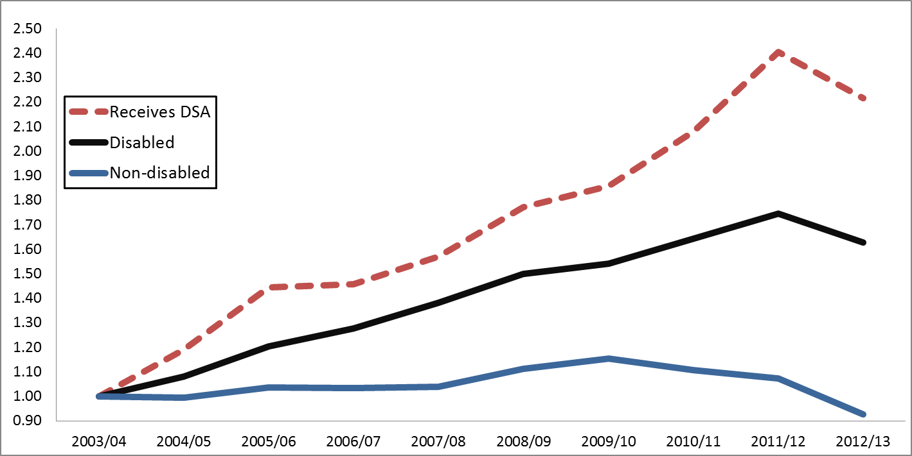
Growth of first year students by disability status (2003/04-2012/13)
The base year is 2003/04 (Index 2003/4 = 1.00).
18

Slide 14
Ethnicity
= 44% of all Black, Pakistani, Bangladeshi and Indian graduates attended post-1992 universities, or former polytechnics compared to 34% of other ethnic groups (National Equality Panel, 2009)
= All minority ethnic groups, with the exception of students from Chinese backgrounds, are more likely to be at ‘new’ institutions (Runnymede, 2007)
= Ethnic minority students more likely to choose to go to university close to home
19

Slide 15
Advantaged and disadvantaged students
The gap between advantaged and disadvantaged students going into higher education has narrowed from 30.5% in 2010 to 29.8% in 2013. (Independent Commission on Fees 2014)
However, the gap between advantaged and disadvantaged students remains large for the most selective universities – will we see greater polarisation?
15

Slide 16
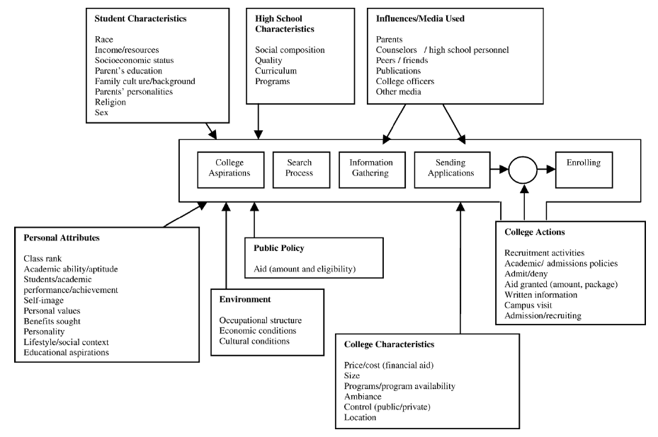
HE student choice model
Vrontis, D., A. Thrassou, and Y. Melanthiou. 2007. A contemporary higher education student choice model for developed countries. Journal of Business Research 60: 879–989.

Slide 17
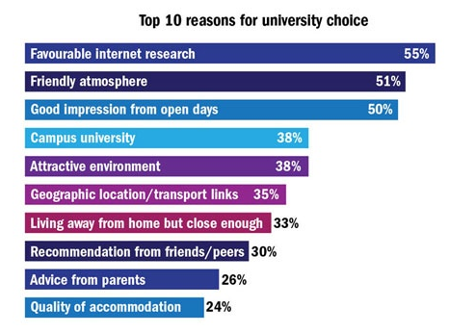
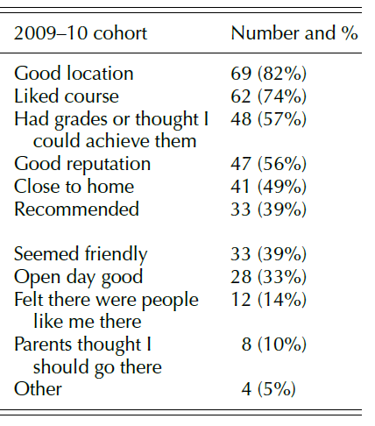
Decision-making
Reasons for choosing university
http://www.timeshighereducation.co.uk/news/sodexo-times-higher-education-university-lifestyle-survey-results/2011981.article
Harding, D. Choice and Information in the public sector: a higher education case study. Social Policy and Society, Vol 11, April 2012. pp 171-192.

Slide 18
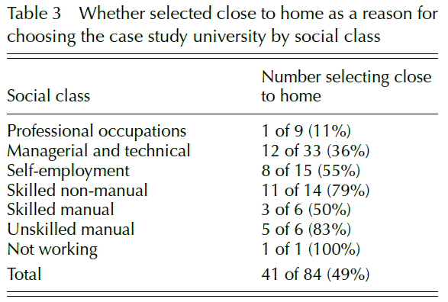
Diverse students with diverse needs
Proximity to home
SEC:
- A range of academic studies have found proximity to home to be a more significant factor for students from lower socioeconomic backgrounds.
Ethnicity:
- Some BME groups more likely to attend local university
Disability:
- Choice constrained, especially with personal care packages
Harding, D. Choice and Information in the public sector: a higher education case study. Social Policy and Society, Vol 11, April 2012. pp 171-192.

Slide 19
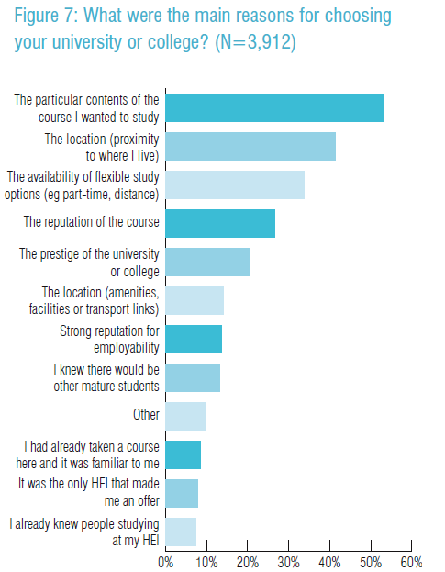
Mature students
Research by NUS and million+ found mature students often had to balance educational factors with pragmatic considerations
Proximity to where I live ranked was the second most frequently cited reason
Availability of flexibility study options (e.g. part-time, distance)
McVitty, D. et. al. Never too late to learn: mature students in higher education. NUS, million+.

Slide 20
People like me
A number of studies have shown that the composition of the student body and surrounding areas played a part in students’ university choices.
Sexual orientation: Qualitative study found some gay students consciously did not apply to universities situation in places they assumed would be governed by certain values regarding sexuality and gender (Taulke-Johnson, 2010).
Race: BME respondents surveyed identified a “multicultural and international student body” as a factor influencing their choice of university (Rupra-Daine and Neave, 2009).
Religion and belief: Anecdotal evidence on for example Jewish students and Hillel houses; other students choosing ones that identify with their faith; feel safe.
“E University has obviously got a much better reputation and is a much better university, but E doesn’t really have much of a gay scene at all ...
That did play a part in my [university] choice.”
Taulke-Johnson, R. “Queer decisions? Gay male students’ university choices.” Studies in higher education. 2010. 35 (3), p. 247.

Slide 21
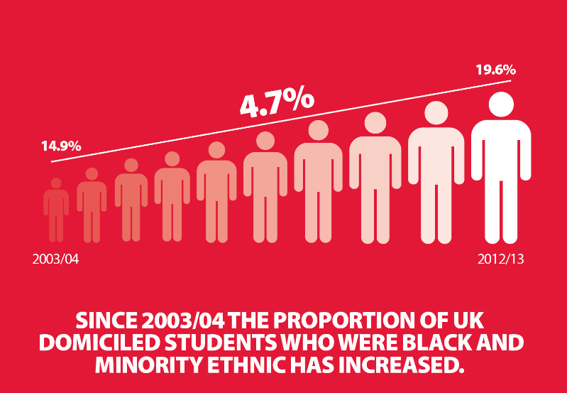
Social justice?

Slide 22
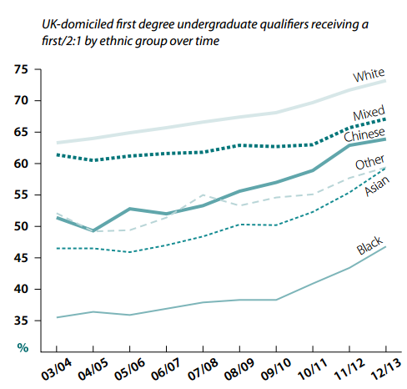
Social Justice?

Slide 23
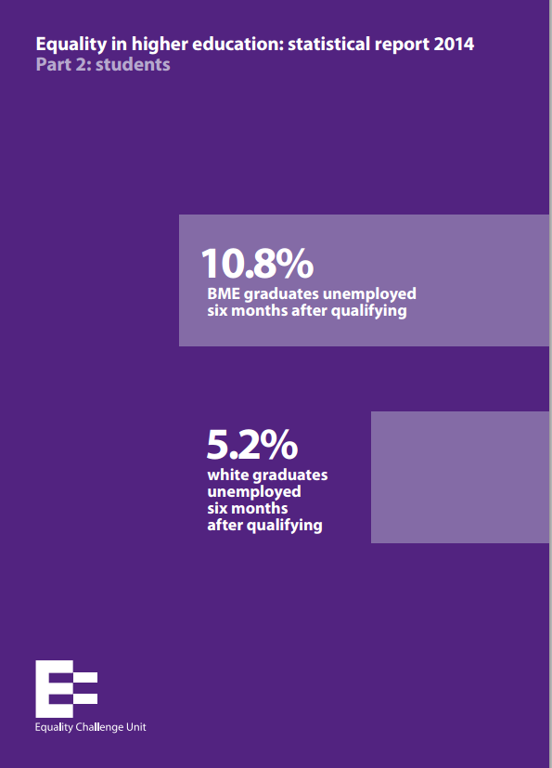
Social Justice?

Slide 24
What next?
Elections 2015
Comprehensive Spending Review
Changes to disabled student support

Slide 25
Contact
Gary Loke
gary.loke@ecu.ac.uk
020 7438 1024
@ECUGary

